Slide 1
This is CS50

Slide 2
Announcements
Masks are required. Please do not put classmates in a position of risk or discomfort by not adhering to protocol. And please do not put staff in a position of having to remind or escalate. Step outside or watch online instead.
If you'd like to view the projector screen on your own laptop during class and/or ask Carter questions via chat, visit cs50.ly/sanders, which will open a Zoom webinar. Be sure to mute your audio, as this week's webinar also contains video for those in isolation or quarantine.

Slide 3
This is CS50

Slide 4
#include <stdio.h>
int main(void) {
printf("hello, world\n");
}

Slide 5
print("hello, world")

Slide 6
arrays

Slide 8
 | 1 | 2 | 3

Slide 9
 | 1 | 2 | 3

Slide 10
 | 1 | 2 | 3

Slide 11

 | 1 | 2 | 3 | h | e | l | l
o | , |  | w | o | r | l | d
\0

Slide 12
 | 1 | 2 | 3

Slide 13
 | 1 | 2 | 3
 | 1

Slide 14
 | 1 | 2 | 3
 | 1 | 2

Slide 15
 | 1 | 2 | 3
 | 1 | 2 | 3

Slide 16
 | 1 | 2 | 3

Slide 17
 | 1 | 2 | 3 | 4
Notes:
list{0,1,2}.c

Slide 18
O(n²)
O(n log n)
O(n)
O(log n)
O(1)

Slide 19
O(n²)
O(n log n)
O(n)
O(log n) search
O(1)

Slide 20
O(n²)
O(n log n)
O(n) insert
O(log n) search
O(1)

Slide 21
Ω(n²)
Ω(n log n)
Ω(n)
Ω(log n)
Ω(1)

Slide 22
Ω(n²)
Ω(n log n)
Ω(n)
Ω(log n)
Ω(1) insert, search

Slide 23
data structures

Slide 24
struct
.
*

Slide 25
struct
->

Slide 26
linked lists

Slide 28
 | 1 0x123

Slide 29
 | 1 0x123
 |  |  | 2 0x456

Slide 30
 | 1 0x123
 |  |  | 2 0x456
 |  |  |  |  | 3 0x789

Slide 31
 | 1 0x123
 |  |  | 2 0x456
 |  |  |  |  | 3 0x789

Slide 32
 | 1 0x123
 | 0x456 |  | 2 0x456
 |  |  |  |  | 3 0x789

Slide 33
 | 1 0x123
 | 0x456 |  | 2 0x456
 |  |  | 0x789 |  | 3 0x789

Slide 34
 | 1 0x123
 | 0x456 |  | 2 0x456
 |  |  | 0x789 |  | 3 0x789
 |  |  |  |  | 0x0

Slide 35
 | 1 0x123
 | 0x456 |  | 2 0x456
 |  |  | 0x789 |  | 3 0x789
 |  |  |  |  | NULL

Slide 36
 | 1
 |  |  | 2
 |  |  |  |  | 3

Slide 37
typedef struct
{
string name;
string number;
}
person;

Slide 38
typedef struct
{
}
person;

Slide 39
typedef struct
{
}
node;

Slide 40
typedef struct
{
int number;
}
node;

Slide 41
typedef struct
{
int number;
node *next;
}
node;

Slide 42
typedef struct node
{
int number;
node *next;
}
node;

Slide 43
typedef struct node
{
int number;
struct node *next;
}
node;

Slide 44
node *list;

Slide 45
list

Slide 46
node *list = NULL;

Slide 47
list

Slide 48
node *n = malloc(sizeof(node));

Slide 49
list
n

Slide 50
if (n != NULL)
{
(*n).number = 1;
}

Slide 51
if (n != NULL)
{
n->number = 1;
}

Slide 52
list
1
n

Slide 53
if (n != NULL)
{
n->next = NULL;
}

Slide 54
list
1
n

Slide 55
list = n;

Slide 56
list
1
n

Slide 57
list
1

Slide 58
node *n = malloc(sizeof(node));
if (n != NULL)
{
n->number = 2;
n->next = NULL;
}

Slide 59
2
list
1
n

Slide 60
list->next = n;

Slide 61
2
list
1
n

Slide 62
2
list
1

Slide 63
node *n = malloc(sizeof(node));
if (n != NULL)
{
n->number = 3;
n->next = NULL;
}

Slide 64
2
list
1
3
n

Slide 65
list->next->next = n;

Slide 66
2
list
1
3
n

Slide 67
2
list
1
3
Notes:
list3.c

Slide 68
list
Notes:
volunteers

Slide 69
list
2

Slide 70
list
2

Slide 71
4
list
2

Slide 72
4
list
2

Slide 73
4
list
2
5

Slide 74
4
list
2
5

Slide 75
node *n = malloc(sizeof(node));
if (n != NULL)
{
n->number = 1;
n->next = NULL;
}

Slide 76
4
list
2
5
1

Slide 77
list = n;

Slide 78
4
list
2
5
1

Slide 79
n->next = list;

Slide 80
4
list
2
5
1

Slide 81
list = n;

Slide 82
4
list
2
5
1

Slide 83
4
list
2
5
3
1

Slide 84
4
list
2
5
3
1

Slide 85
4
list
2
5
3
1

Slide 86
O(n²)
O(n log n)
O(n)
O(log n)
O(1)

Slide 87
4
list
2
5
3
1

Slide 88
4
list
2
5
3
1

Slide 89
4
list
2
5
3
1

Slide 90
4
list
2
5
3
1

Slide 91
4
list
2
5
3
1

Slide 92
4
list
2
5
3
1

Slide 93
4
list
2
5
3
1

Slide 94
O(n²)
O(n log n)
O(n) search
O(log n)
O(1)

Slide 95
O(n²)
O(n log n)
O(n) search, insert
O(log n)
O(1)

Slide 96
O(n²)
O(n log n)
O(n) search
O(log n)
O(1) insert

Slide 97
Ω(n²)
Ω(n log n)
Ω(n)
Ω(log n)
Ω(1)

Slide 98
Ω(n²)
Ω(n log n)
Ω(n)
Ω(log n)
Ω(1) insert, search

Slide 99
trees

Slide 100
binary search trees

Slide 101
 | 1 | 2 | 3 | 4 | 5 | 6 | 7

Slide 102
 | 1 | 2 | 3 | 4 | 5 | 6 | 7

Slide 103
 | 1 | 2 | 3 | 4 | 5 | 6 | 7

Slide 104
 | 1 | 2 | 3 | 4 | 5 | 6 | 7

Slide 105
4
2
6
1
3
5
7

Slide 106
4
2
6
1
3
5
7

Slide 107
typedef struct node
{
int number;
struct node *next;
}
node;

Slide 108
typedef struct node
{
int number;
}
node;

Slide 109
typedef struct node
{
int number;
}
node;

Slide 110
typedef struct node
{
int number;
struct node *left;
struct node *right;
}
node;

Slide 111
4
2
6
1
3
5
7
Notes:
tree.c

Slide 112
bool search(node *tree, int number)
{
if (tree == NULL)
{
return false;
}
else if (number < tree->number)
{
return search(tree->left, number);
}
else if (number > tree->number)
{
return search(tree->right, number);
}
else if (number == tree->number)
{
return true;
}
}

Slide 113
bool search(node *tree, int number)
{
if (tree == NULL)
{
return false;
}
else if (number < tree->number)
{
return search(tree->left, number);
}
else if (number > tree->number)
{
return search(tree->right, number);
}
else if (number == tree->number)
{
return true;
}
}

Slide 114
bool search(node *tree, int number)
{
if (tree == NULL)
{
return false;
}
else if (number < tree->number)
{
return search(tree->left, number);
}
else if (number > tree->number)
{
return search(tree->right, number);
}
else if (number == tree->number)
{
return true;
}
}

Slide 115
bool search(node *tree, int number)
{
if (tree == NULL)
{
return false;
}
else if (number < tree->number)
{
return search(tree->left, number);
}
else if (number > tree->number)
{
return search(tree->right, number);
}
else if (number == tree->number)
{
return true;
}
}

Slide 116
bool search(node *tree, int number)
{
if (tree == NULL)
{
return false;
}
else if (number < tree->number)
{
return search(tree->left, number);
}
else if (number > tree->number)
{
return search(tree->right, number);
}
else if (number == tree->number)
{
return true;
}
}

Slide 117
bool search(node *tree, int number)
{
if (tree == NULL)
{
return false;
}
else if (number < tree->number)
{
return search(tree->left, number);
}
else if (number > tree->number)
{
return search(tree->right, number);
}
else if (number == tree->number)
{
return true;
}
}

Slide 118
4
2
6
1
3
5
7

Slide 119
2
1
3

Slide 120
1
2
3

Slide 121
O(n²)
O(n log n)
O(n)
O(log n)
O(1)

Slide 122
O(n²)
O(n log n)
O(n)
O(log n) search
O(1)

Slide 123
O(n²)
O(n log n)
O(n)
O(log n) search, insert
O(1)

Slide 124
Ω(n²)
Ω(n log n)
Ω(n)
Ω(log n)
Ω(1)

Slide 125
1

Slide 126
2
1

Slide 127
3
2
1

Slide 128
Ω(n²)
Ω(n log n)
Ω(n)
Ω(log n)
Ω(1) insert, search

Slide 129
hash tables

Slide 131
0
1
2
3
4
5
6
7
8
9
10
11
12
13
14
15
16
17
18
19
20
21
22
23
24
25

Slide 132
A
B
C
D
E
F
G
H
I
J
K
L
M
N
O
P
Q
R
S
T
U
V
W
X
Y
Z

Slide 134
Albus

Slide 135
Albus
Zacharias

Slide 136
Albus
Hermione
Zacharias

Slide 137
Albus
Ginny
Hermione
Zacharias

Slide 138
Albus
Ginny
Hermione
Ron
Zacharias

Slide 139
Albus
Fred
Ginny
Hermione
Ron
Zacharias

Slide 140
Albus
Fred
Ginny
Hermione
Ron
Severus
Zacharias

Slide 141
Albus
Fred
Ginny
Hermione
Petunia
Ron
Severus
Zacharias

Slide 142
Albus
Draco
Fred
Ginny
Hermione
Petunia
Ron
Severus
Zacharias

Slide 143
Albus
Draco
Fred
Ginny
Hermione
James
Petunia
Ron
Severus
Zacharias

Slide 144
Albus
Cedric
Draco
Fred
Ginny
Hermione
James
Petunia
Ron
Severus
Zacharias

Slide 145
Albus
Cedric
Draco
Fred
Ginny
Hermione
James
Luna
Petunia
Ron
Severus
Zacharias

Slide 146
Albus
Cedric
Draco
Fred
Ginny
Hermione
James
Luna
Neville
Petunia
Ron
Severus
Zacharias

Slide 147
Albus
Cedric
Draco
Fred
Ginny
Hermione
James
Kingsley
Luna
Neville
Petunia
Ron
Severus
Zacharias

Slide 148
Albus
Cedric
Draco
Fred
Ginny
Hermione
James
Kingsley
Luna
Minerva
Neville
Petunia
Ron
Severus
Zacharias

Slide 149
Albus
Cedric
Draco
Fred
Ginny
Hermione
James
Kingsley
Luna
Minerva
Neville
Petunia
Ron
Severus
Vernon
Zacharias

Slide 150
Albus
Cedric
Draco
Fred
Ginny
Hermione
Harry
James
Kingsley
Luna
Minerva
Neville
Petunia
Ron
Severus
Vernon
Zacharias

Slide 151
Albus
Cedric
Draco
Fred
Ginny
Hermione
Harry
Hagrid
James
Kingsley
Luna
Minerva
Neville
Petunia
Ron
Severus
Vernon
Zacharias

Slide 152
Albus
Cedric
Draco
Fred
Ginny
Hermione
Harry
Hagrid
James
Kingsley
Luna
Minerva
Neville
Petunia
Ron
Severus
Sirius
Vernon
Zacharias

Slide 153
Albus
Cedric
Draco
Fred
Ginny
Hermione
Harry
Hagrid
James
Kingsley
Luna
Minerva
Neville
Petunia
Ron
Remus
Severus
Sirius
Vernon
Zacharias

Slide 154
Albus
Cedric
Draco
Fred
Ginny
George
Hermione
Harry
Hagrid
James
Kingsley
Luna
Minerva
Neville
Petunia
Ron
Remus
Severus
Sirius
Vernon
Zacharias

Slide 155
Albus
Cedric
Draco
Fred
Ginny
George
Hermione
Harry
Hagrid
James
Kingsley
Luna
Lily
Minerva
Neville
Petunia
Ron
Remus
Severus
Sirius
Vernon
Zacharias

Slide 156
Albus
Cedric
Draco
Fred
Ginny
George
Hermione
Harry
Hagrid
James
Kingsley
Luna
Lily
Lucius
Minerva
Neville
Petunia
Ron
Remus
Severus
Sirius
Vernon
Zacharias

Slide 157
typedef struct node
{
char word[LONGEST_WORD + 1];
struct node *next;
}
node;

Slide 158
node *hash_table[NUMBER_OF_BUCKETS];

Slide 159
input →
→ output

Slide 160
hash function

Slide 161
Albus →
→ 0

Slide 162
Zacharias →
→ 25

Slide 163
Albus
Cedric
Draco
Fred
Ginny
George
Hermione
Harry
Hagrid
James
Kingsley
Luna
Lily
Lucius
Lavender
Minerva
Neville
Petunia
Ron
Remus
Severus
Sirius
Vernon
Zacharias

Slide 164
Hermione
Harry
Hagrid

Slide 165
A
B
C
D
E
F
G
H
I
J
K
L
M
N
O
P
Q
R
S
T
U
V
W
X
Y
Z
Hermione
Harry
Hagrid

Slide 166
H

Slide 167
Ha

Slide 168
Ha
Hb

Slide 169
Ha
Hb
Hc

Slide 170
Ha
Hb
Hc
Hd

Slide 171
Ha
Hb
Hc
Hd
He

Slide 172
Ha
Hb
Hc
Hd
He
Hf

Slide 173
Ha
Hb
Hc
Hd
He
Hf
Hermione

Slide 174
Ha
Hb
Hc
Hd
He
Hf
Harry
Hermione

Slide 175
Ha
Hb
Hc
Hd
He
Hf
Harry
Hagrid
Hermione
Notes:
676 buckets

Slide 176
Ha

Slide 177
Haa

Slide 178
Haa
Hab

Slide 179
Haa
Hab
Hac

Slide 180
Haa
Hab
Hac
Had

Slide 181
Haa
Hab
Hac
Had
Hae

Slide 182
Haa
Hab
Hac
Had
Hae
Haf

Slide 183
Haa
Hab
Hac
Had
Hae
Haf
Hag
...

Slide 184
Haa
Hab
Hac
Had
Hae
Haf
Hag
...
Haq

Slide 185
Haa
Hab
Hac
Had
Hae
Haf
Hag
...
Haq
Har

Slide 186
Haa
Hab
Hac
Had
Hae
Haf
Hag
...
Haq
Har
Has
...

Slide 187
Haa
Hab
Hac
Had
Hae
Haf
Hag
...
Haq
Har
Has
...
Heq

Slide 188
Haa
Hab
Hac
Had
Hae
Haf
Hag
...
Haq
Har
Has
...
Heq
Her

Slide 189
Haa
Hab
Hac
Had
Hae
Haf
Hag
...
Haq
Har
Has
...
Heq
Her
Hes

Slide 190
Haa
Hab
Hac
Had
Hae
Haf
Hag
...
Haq
Har
Has
...
Heq
Her
Hes
Hermione

Slide 191
Haa
Hab
Hac
Had
Hae
Haf
Hag
...
Haq
Har
Has
...
Heq
Her
Hes
Harry
Hermione

Slide 192
Haa
Hab
Hac
Had
Hae
Haf
Hag
...
Haq
Har
Has
...
Heq
Her
Hes
Hagrid
Harry
Hermione
Notes:
17,576 buckets

Slide 193
Albus
Cedric
Draco
Fred
Ginny
George
Hermione
Harry
Hagrid
James
Kingsley
Luna
Lily
Lucius
Lavender
Minerva
Neville
Petunia
Ron
Remus
Severus
Sirius
Vernon
Zacharias

Slide 194
O(n²)
O(n log n)
O(n)
O(log n)
O(1)

Slide 195
O(n²)
O(n log n)
O(n) search
O(log n)
O(1)

Slide 196
O(n²)
O(n log n)
O(n) search, insert
O(log n)
O(1)

Slide 197
O(n²)
O(n log n)
O(n) search
O(log n)
O(1) insert

Slide 198
Ω(n²)
Ω(n log n)
Ω(n)
Ω(log n)
Ω(1)

Slide 199
Ω(n²)
Ω(n log n)
Ω(n)
Ω(log n)
Ω(1) insert, search

Slide 200
tries

Slide 201
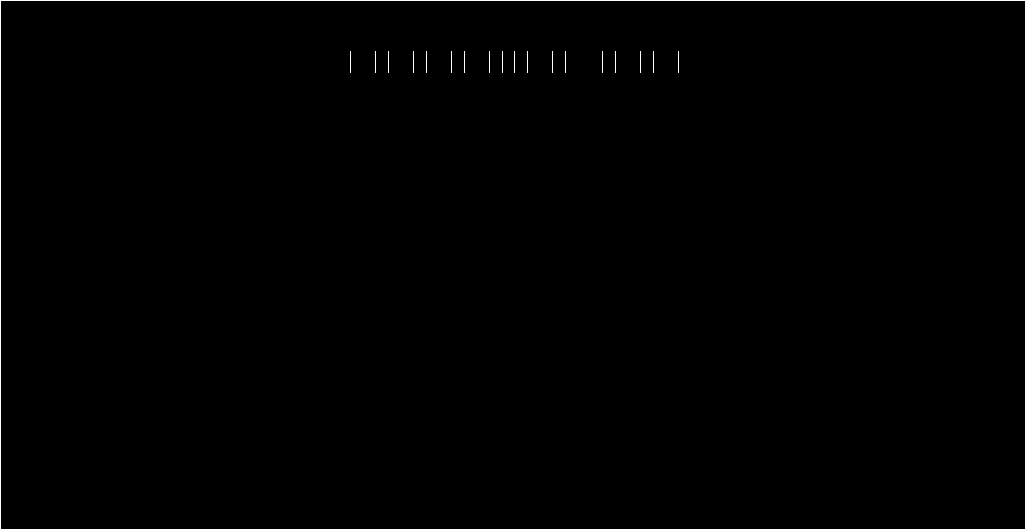

Slide 202
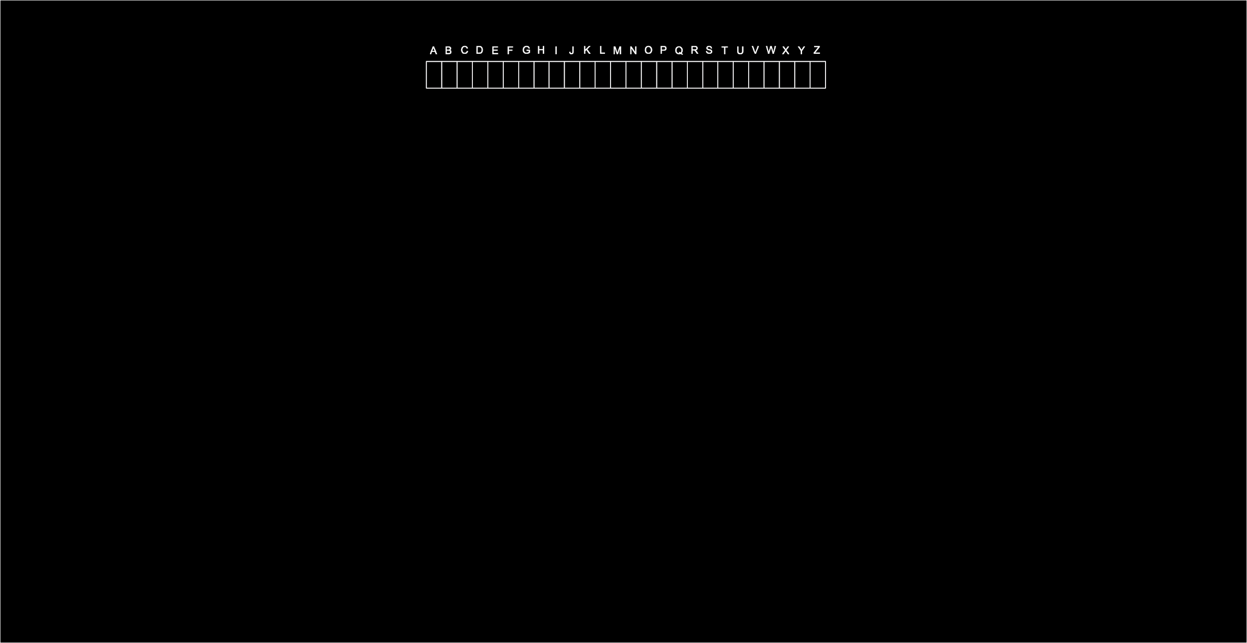

Slide 203
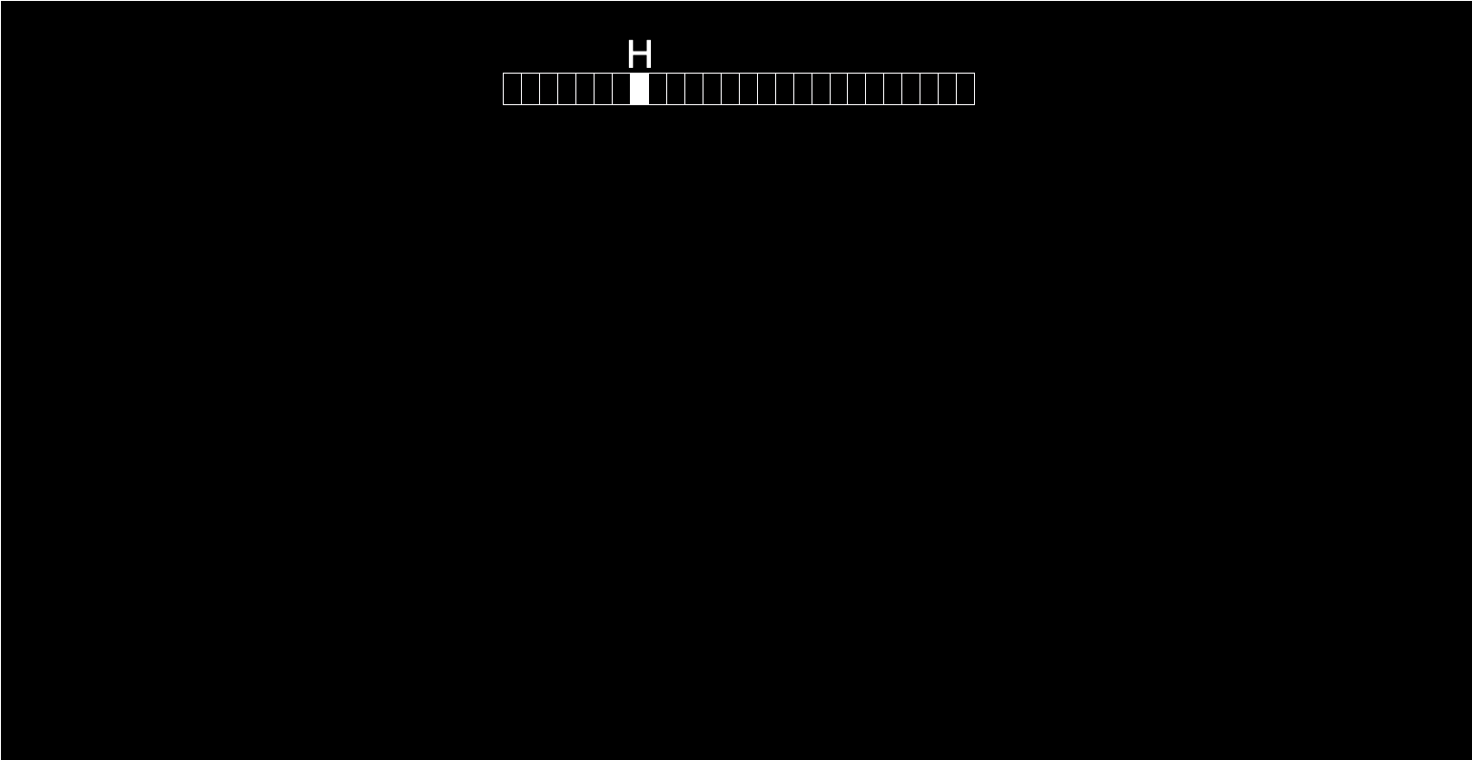

Slide 204
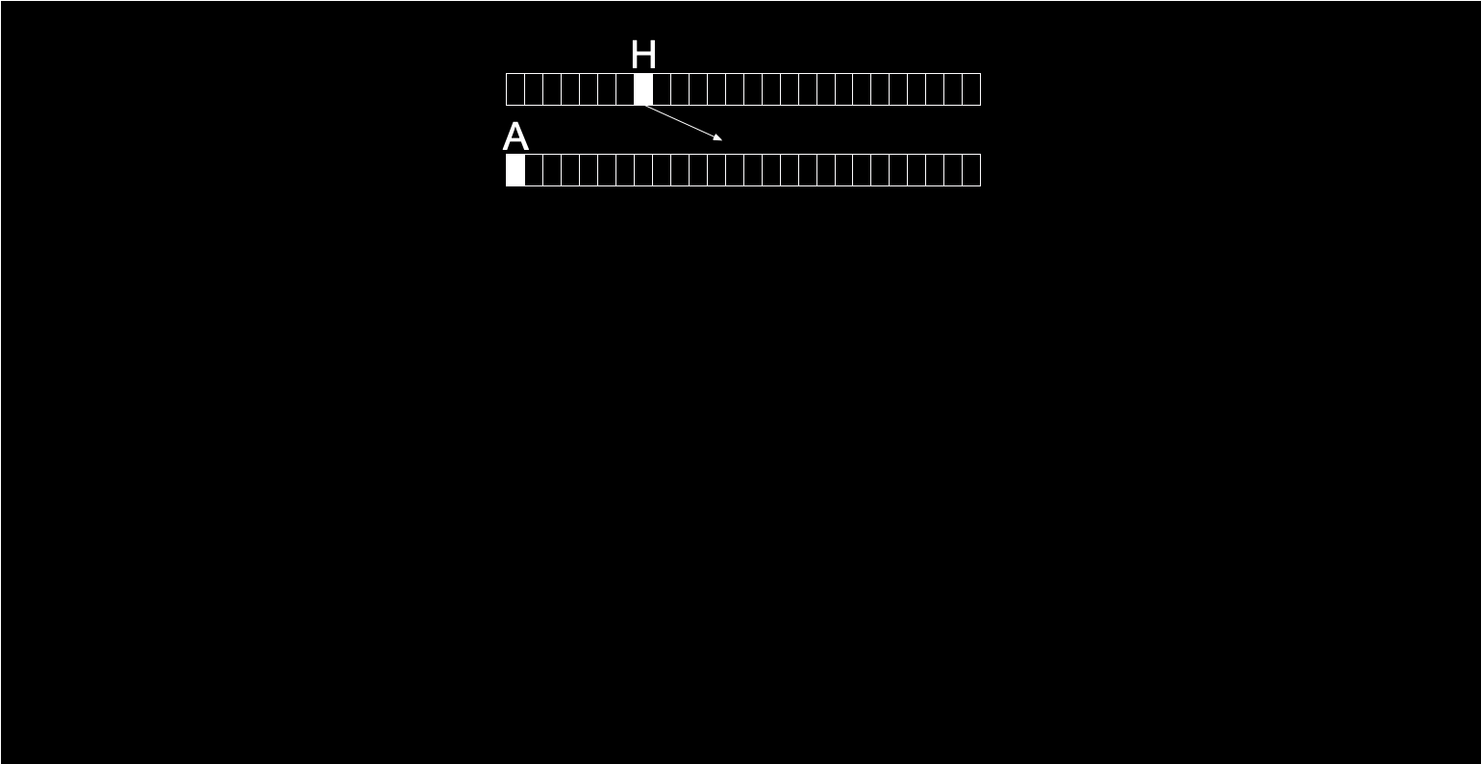

Slide 205
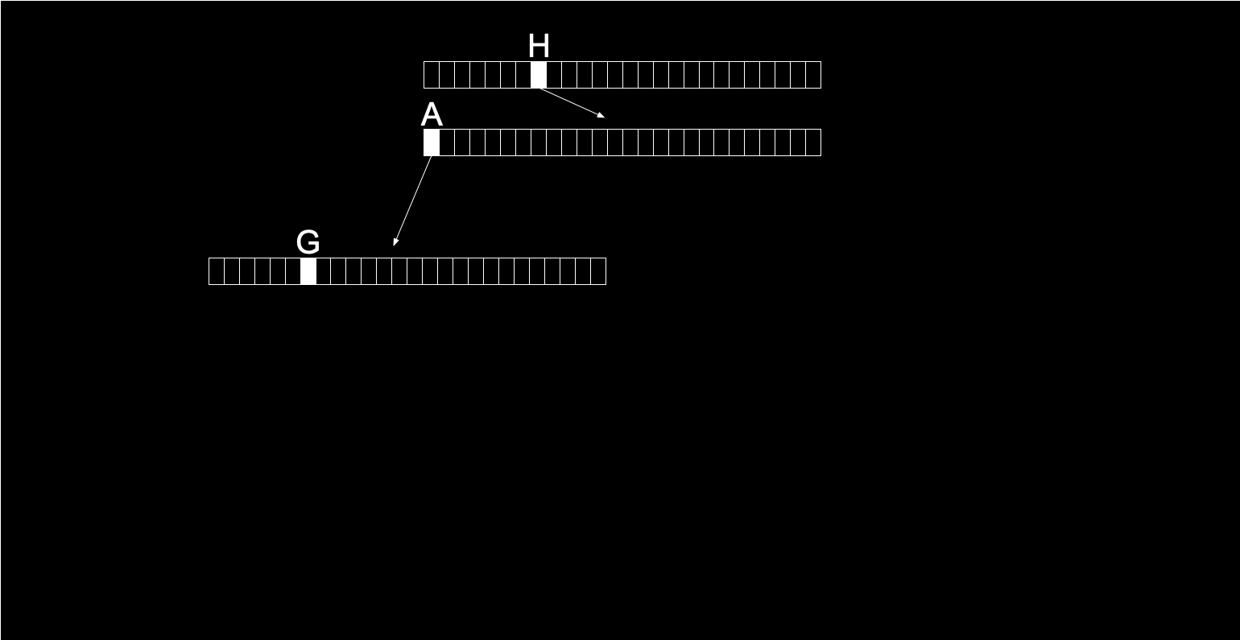

Slide 206
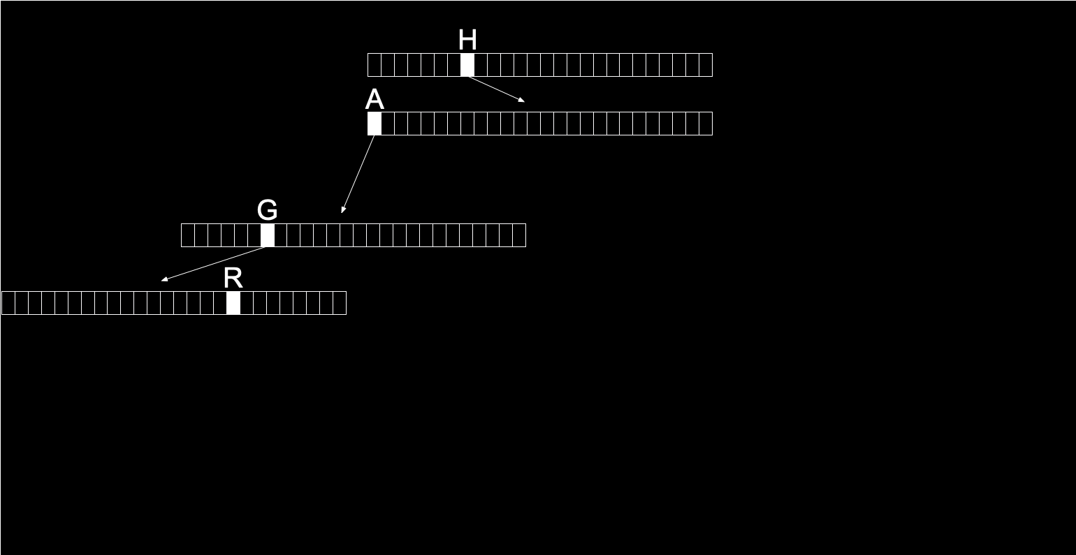

Slide 207
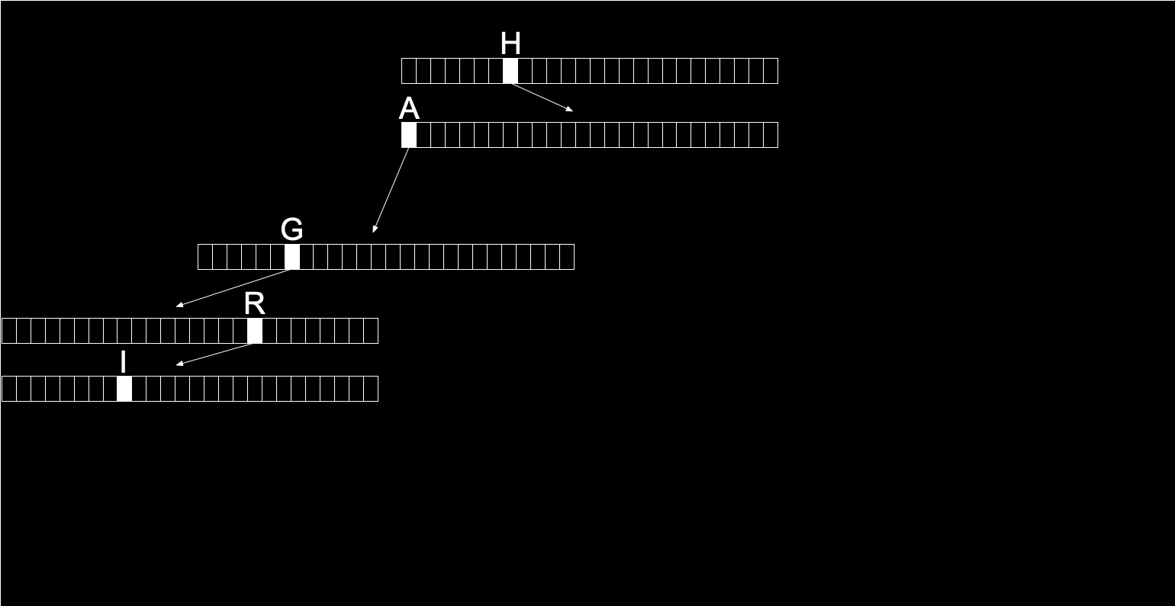

Slide 208
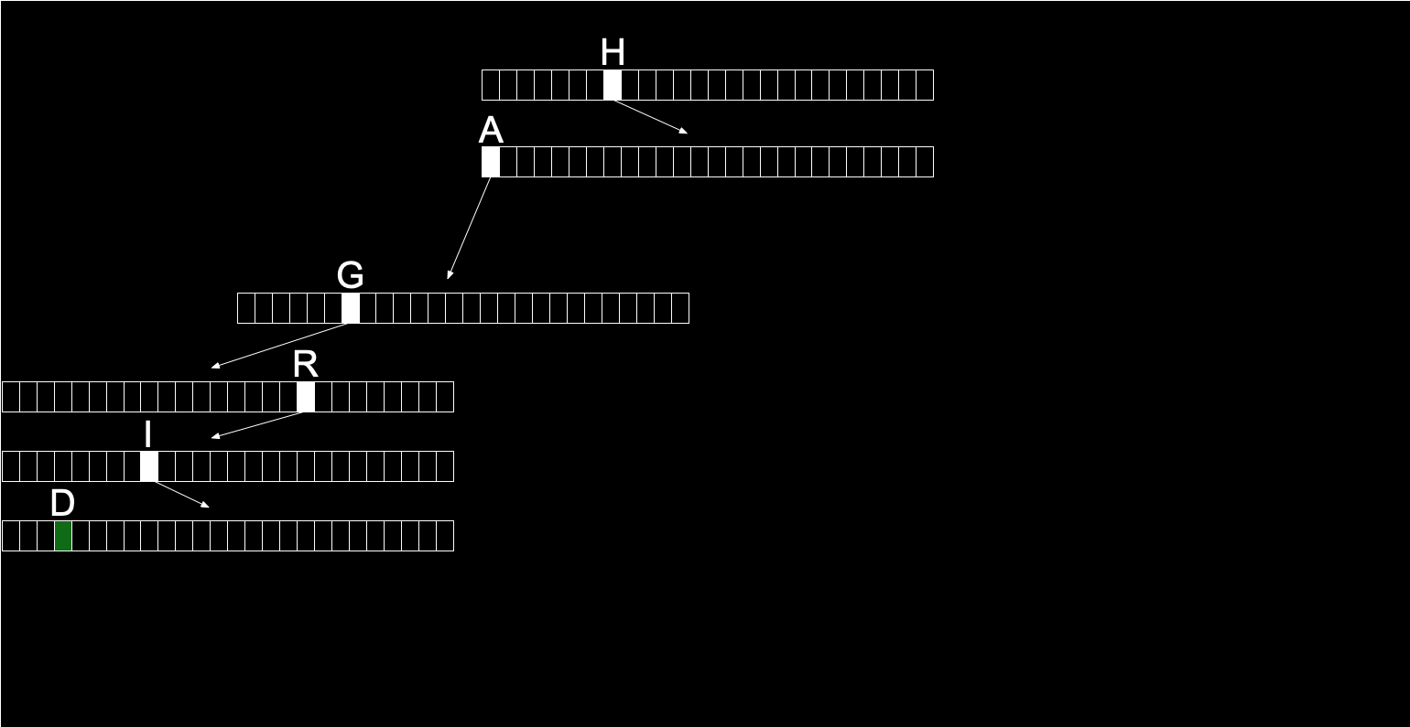

Slide 209
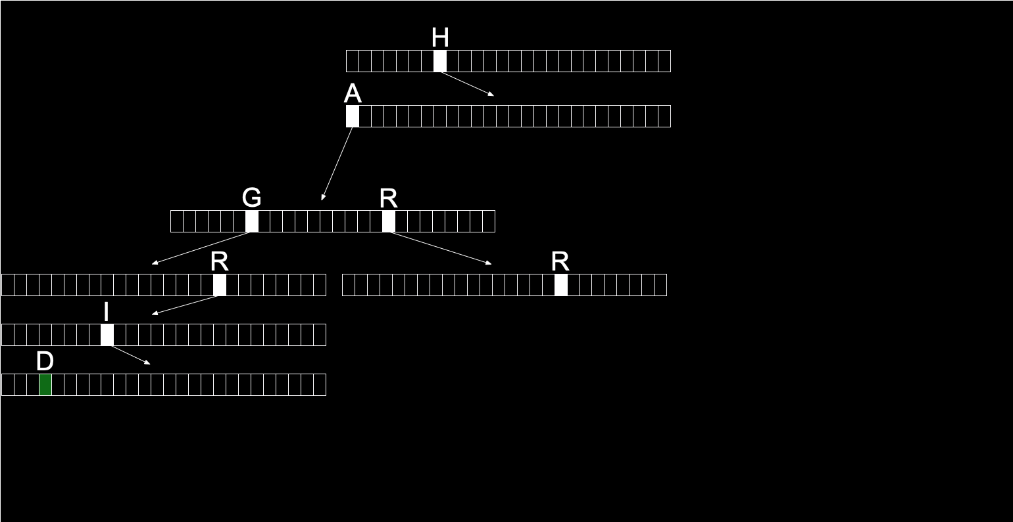

Slide 210
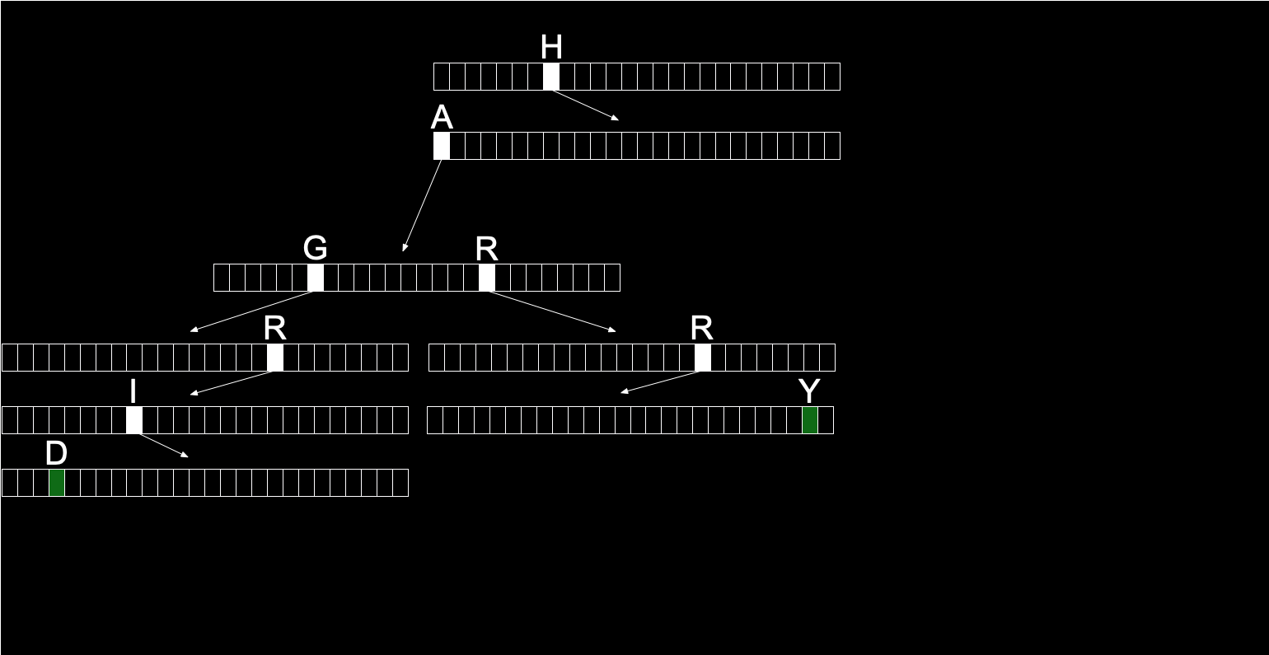

Slide 211
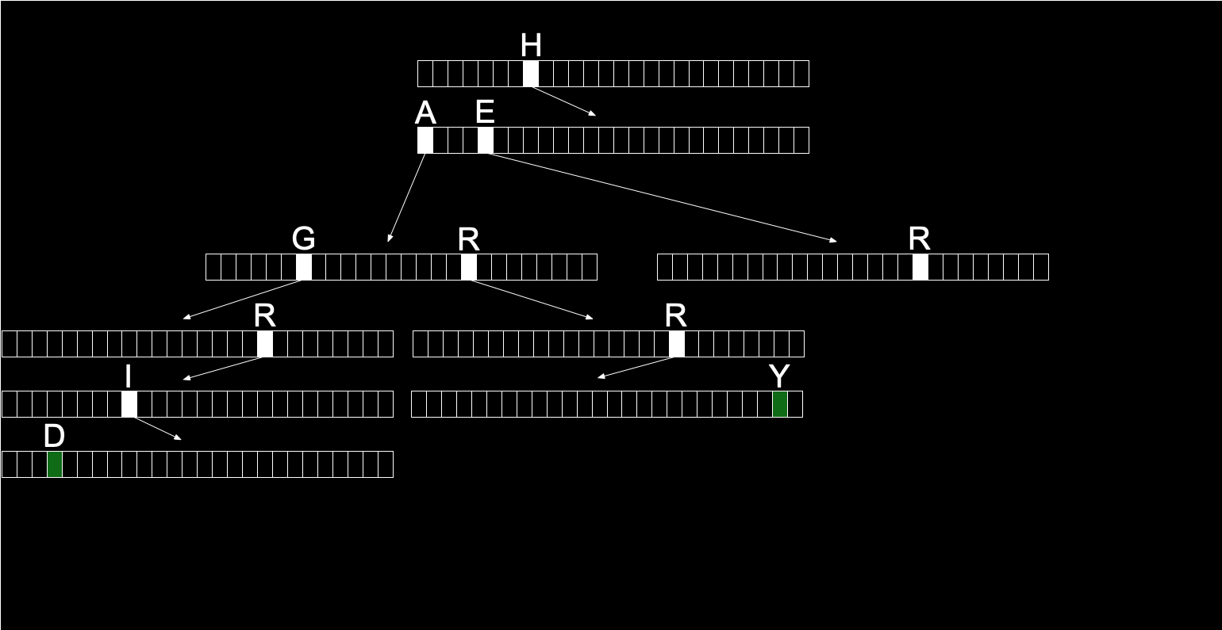

Slide 212
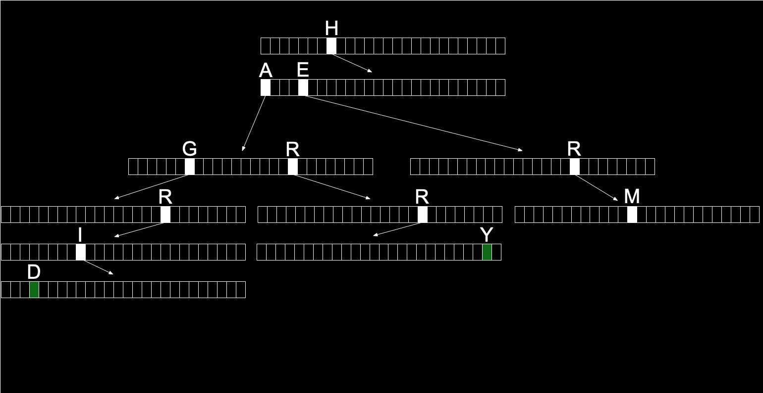

Slide 213
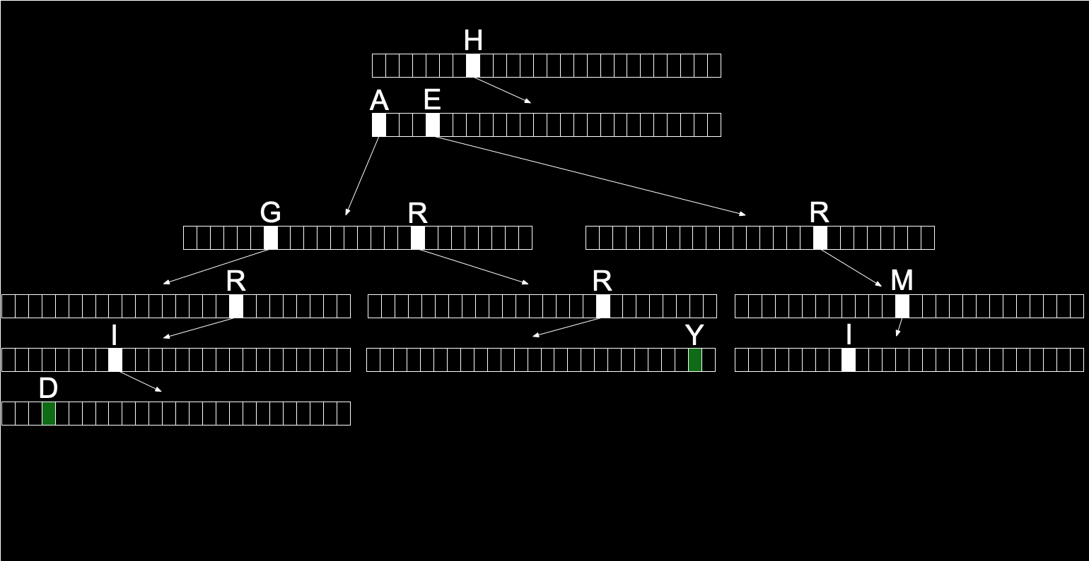

Slide 214
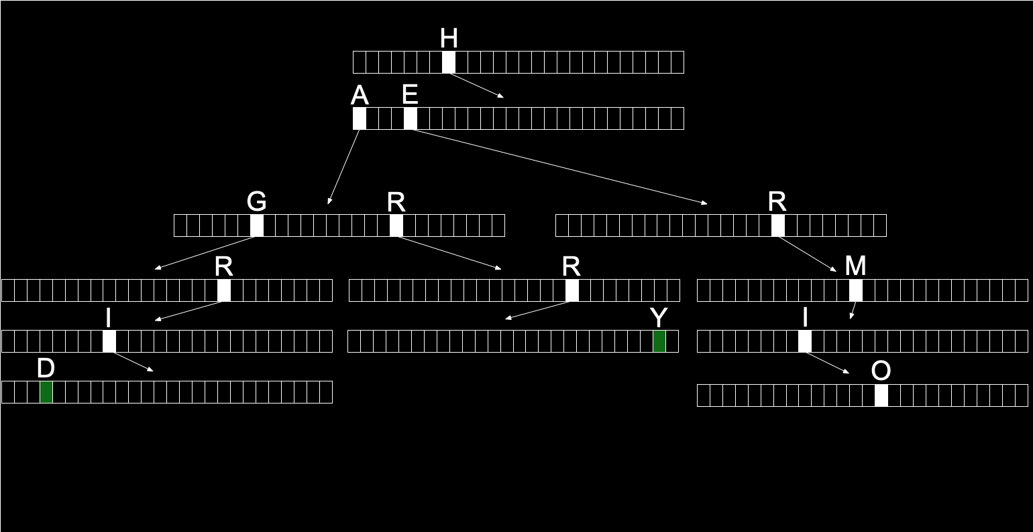

Slide 215
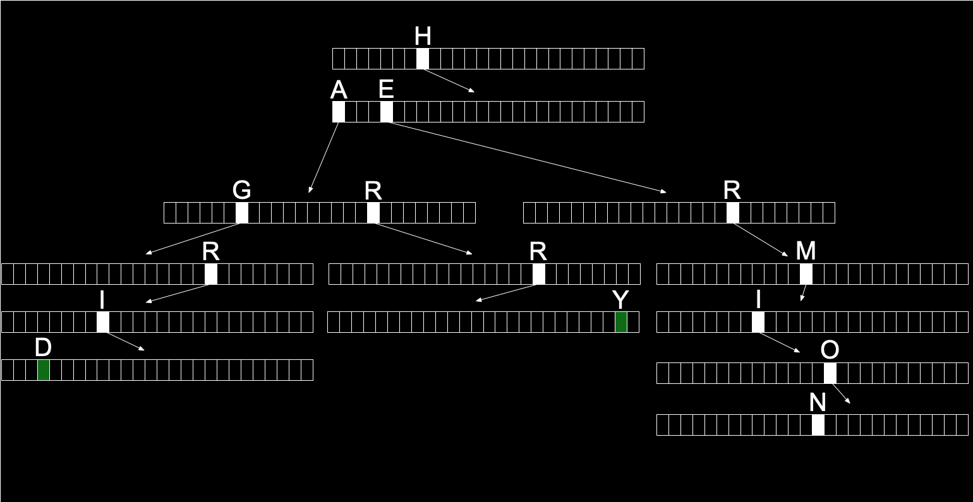

Slide 216
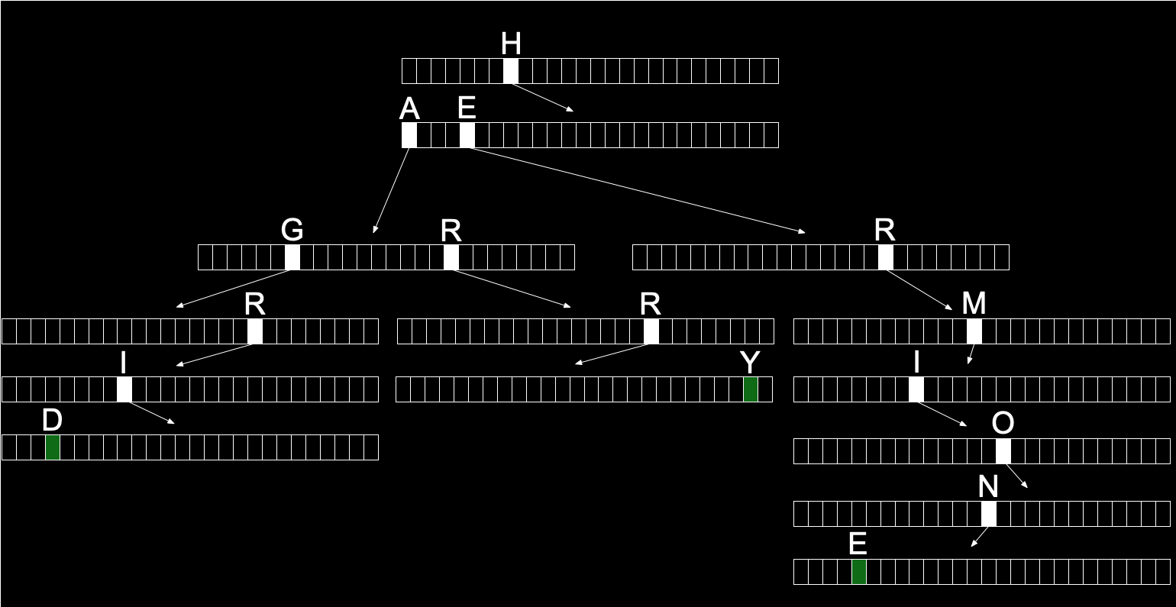

Slide 217
typedef struct node
{
bool is_word;
struct node *children[SIZE_OF_ALPHABET];
}
node;

Slide 218
node* trie;

Slide 219
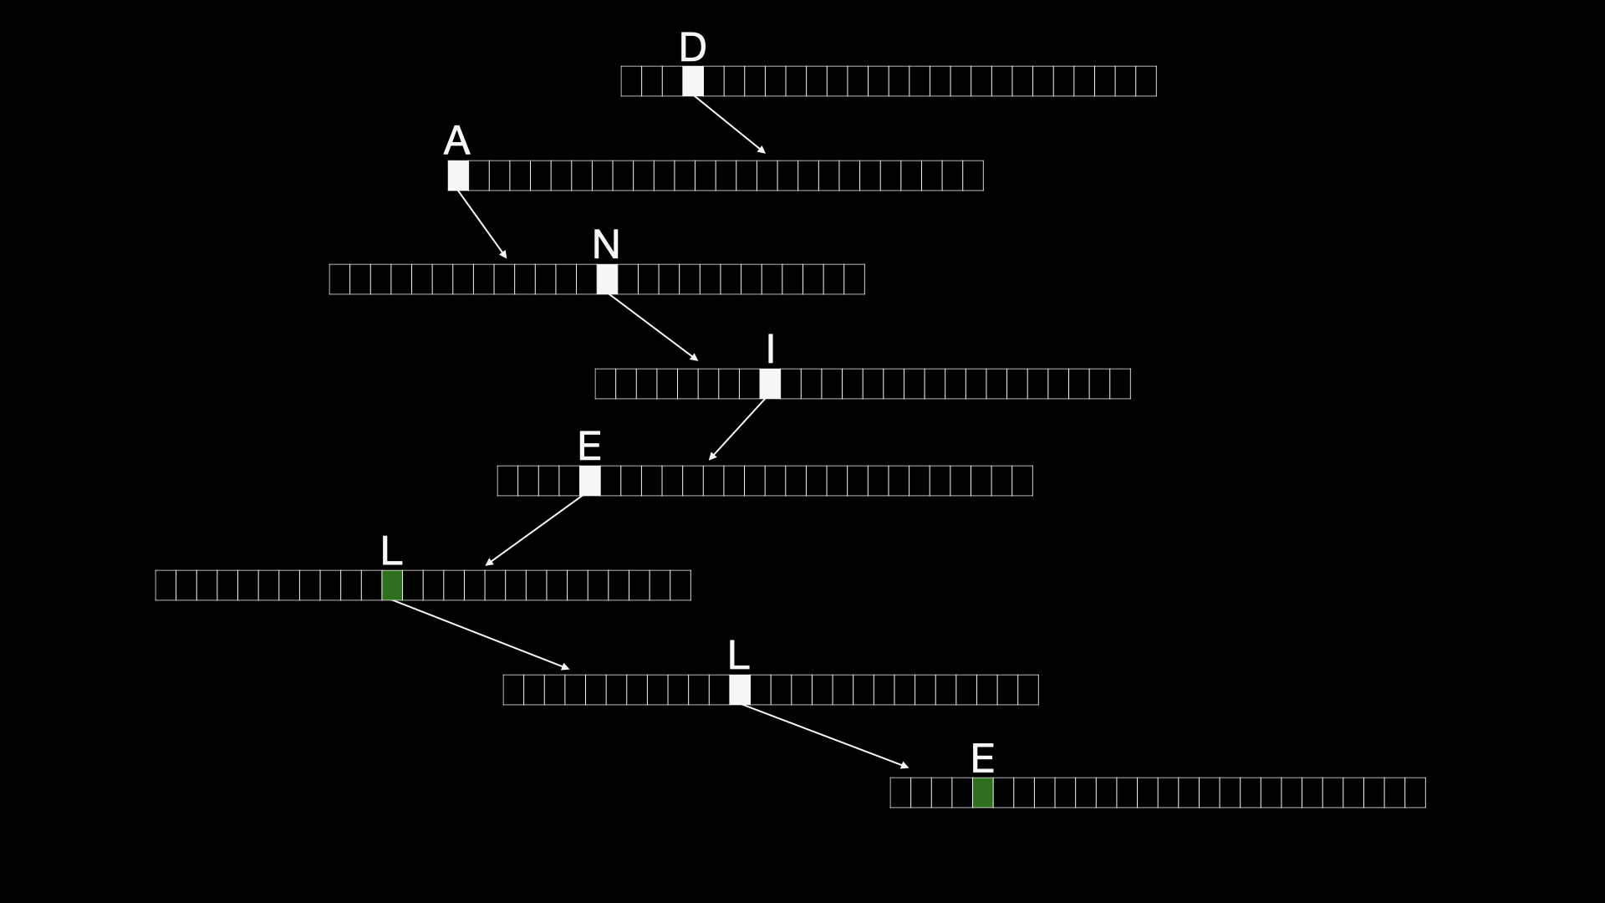

Slide 220
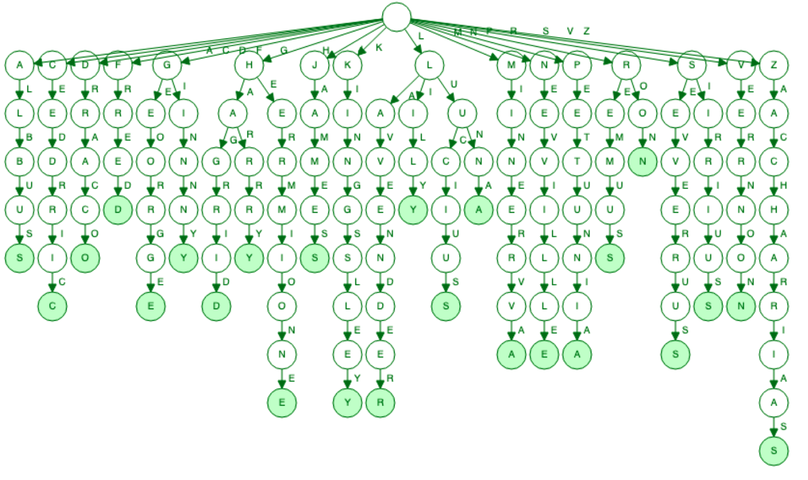
Notes:
https://www.cs.usfca.edu/~galles/visualization/Trie.html

Slide 221
O(n²)
O(n log n)
O(n)
O(log n)
O(1)

Slide 222
O(k) search

Slide 223
O(k) search, insert

Slide 224
O(1) search, insert

Slide 225
O(n²)
O(n log n)
O(n)
O(log n)
O(1) search, insert

Slide 226
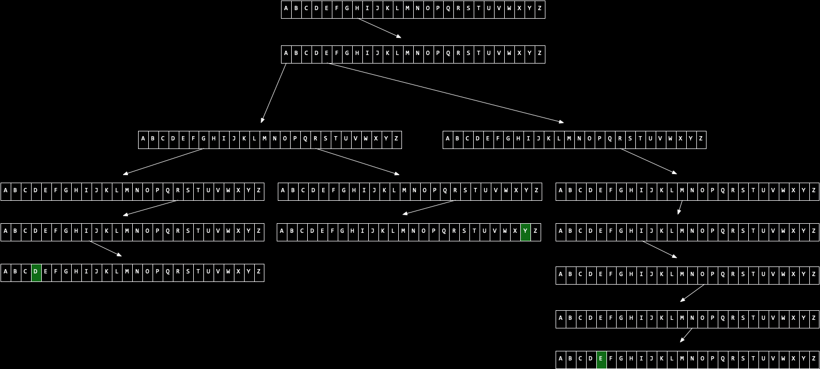

Slide 229
abstract data structures

Slide 230
queues
Notes:
- line at Tasty Burger
- printer queue

Slide 231
FIFO

Slide 232
enqueue
dequeue

Slide 233
stacks
Notes:
- stack of sweaters
- Gmail inbox

Slide 234
LIFO

Slide 235
push
pop

Slide 236
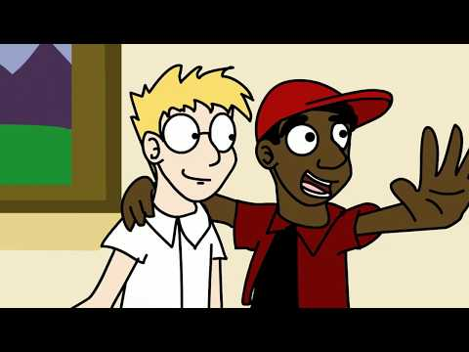
Notes:
https://www.youtube.com/watch?v=ItAG3s6KIEI

Slide 237
dictionaries

Slide 238
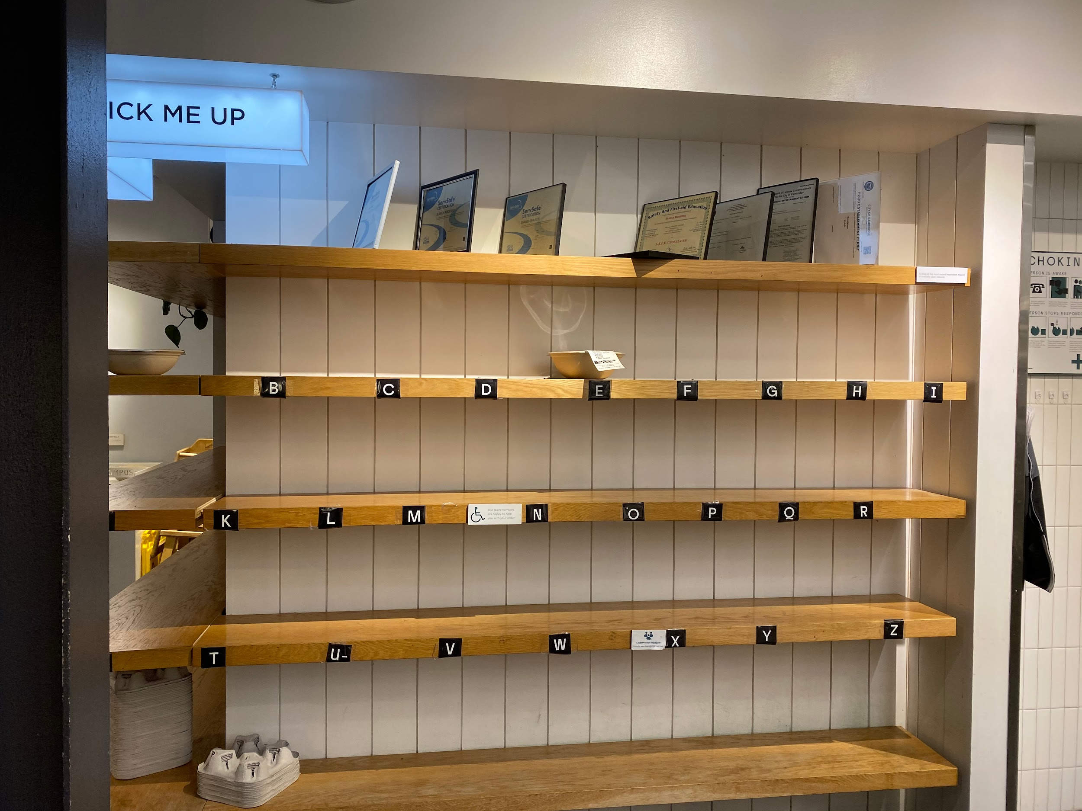

Slide 239
typedef struct node
{
char ch;
struct node *next;
}
node;

Slide 240
node *list;

Slide 241
This was CS50

Slide 242
This was CS50

Slide 243
This was CS50

Slide 244
This was CS50

Slide 245
This was CS50

